Slide 1

NT101-Network Security
Week 03 Packet Sniffing and Spoofing
Ngoc-Tu Nguyen, PhD
tunn@uit.edu.vn

Slide 2
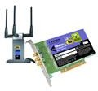
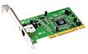








How Packets Are Received?
Overview
NIC (Network Interface Card) is a physical or logical link between a machine and a network
Each NIC has a MAC address
Every NIC on the network will hear all the frames on the wire
NIC checks the destination address for every packet, if the address matches the cards MAC address, it is further copied into a buffer in the kernel
application
transport
network
link
cpu
memory
host bus (e.g., PCI)
controller
link
physical
physical
network interface

Slide 3
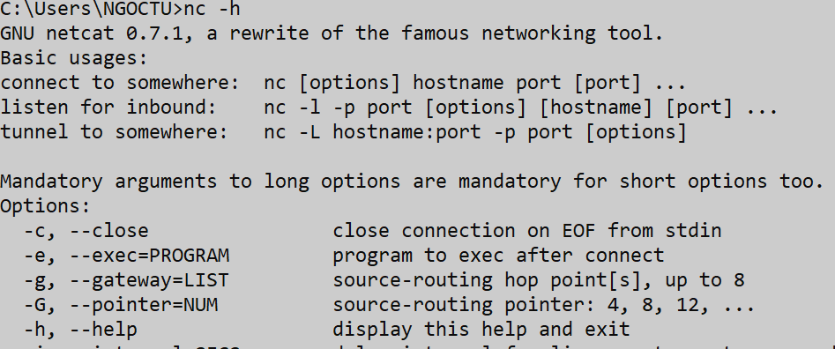
Computer networking utility -netcat
Reading from and writing to network connections using TCP or UDP
application
transport
network
link
cpu
memory
host bus (e.g., PCI)
controller
link
physical
physical
network interface
https://en.wikipedia.org/wiki/Netcat

Slide 4





Sockets
Recall…
process sends/receives messages to/from its socket
socket analogous to door
sending process shoves message out door
sending process relies on transport infrastructure on other side of door to deliver message to socket at receiving process
two sockets involved: one on each side
application
process
socket
application
process
controlled by app developer
transport
transport
network
network
controlled by OS
link
Internet
link
physical
physical

Slide 5
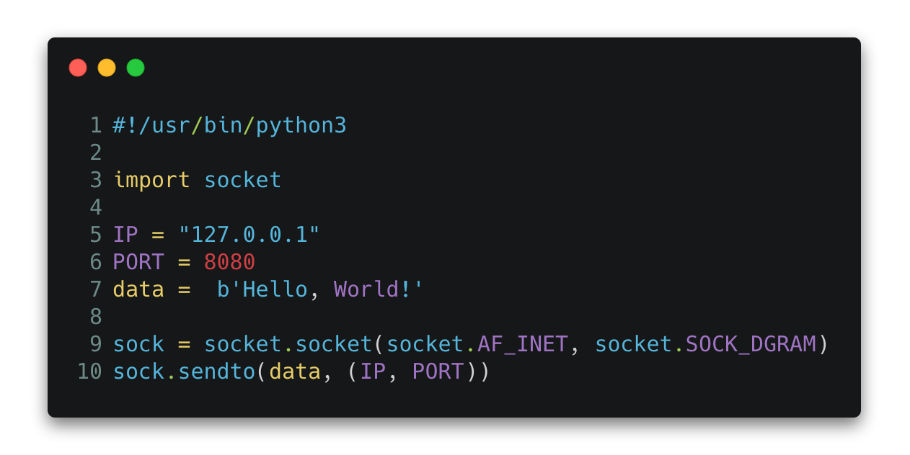

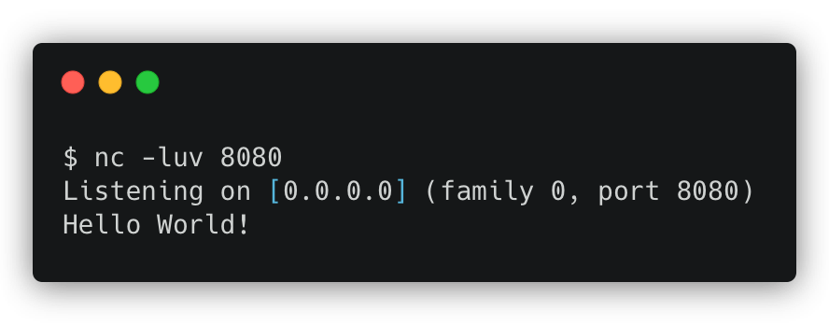
Socket APIs and how to send packets? (cont.)
Python example
UDP Client Example
application
process
controlled by app developer
message segment
M
H_{t} M
transport
H_{t}
datagram
 | H_{n} | H_{t} | M
H_{l} | H_{n} | H_{t} | M
network
OS kernel
H_{n}
frame
link
physical
Execution result
Network
nc standar netcat

Slide 6
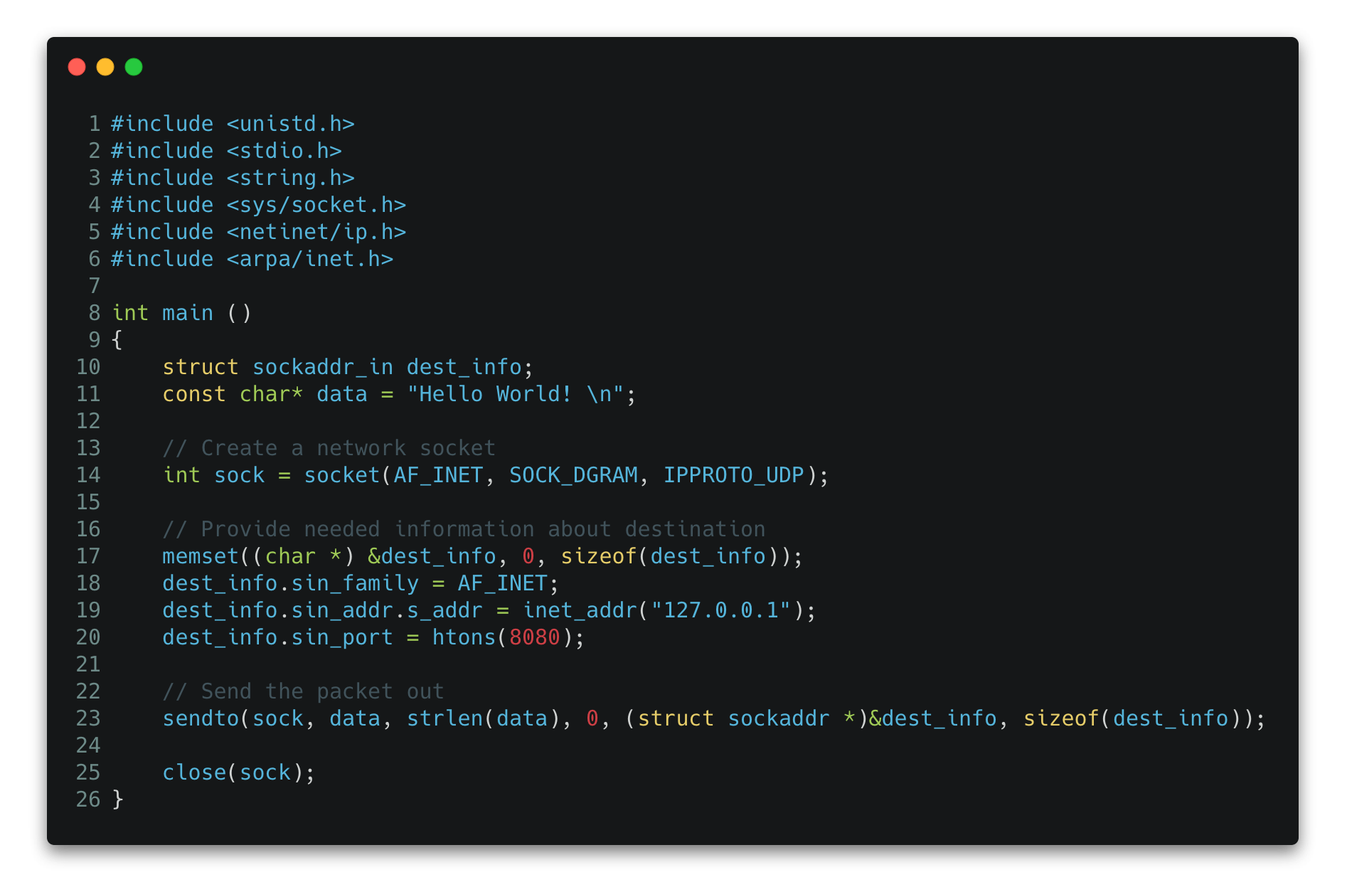
Socket APIs and how to send packets?
C++ version
Python is built on top of C++

Slide 7
How Packets Are Received?
Overview
NIC (Network Interface Card) is a physical or logical link between a machine and a network
Each NIC has a MAC address
Every NIC on the network will hear all the frames on the wire
NIC checks the destination address for every packet, if the address matches the cards MAC address, it is further copied into a buffer in the kernel
application
transport
network
link
cpu
memory
host bus (e.g., PCI)
controller
link
physical
physical
network interface

Slide 8
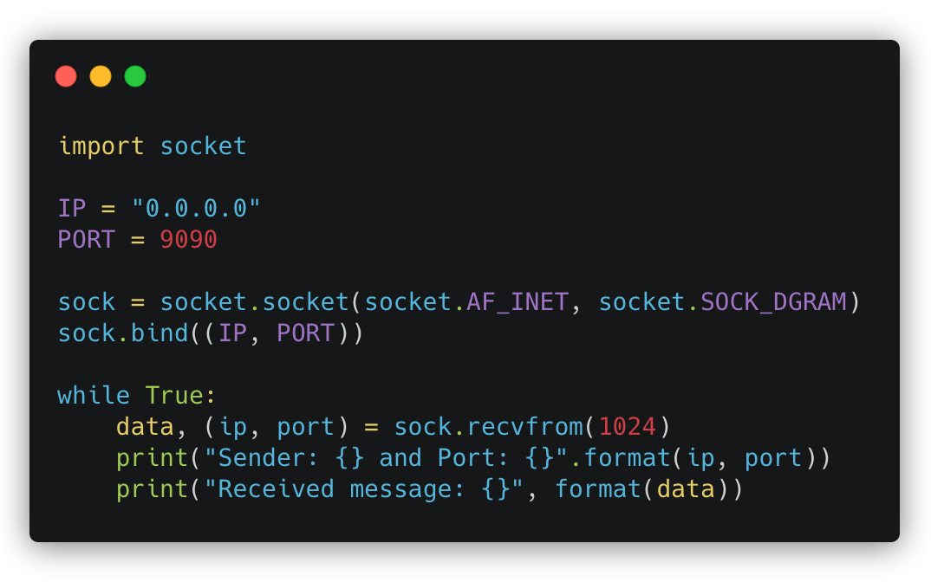
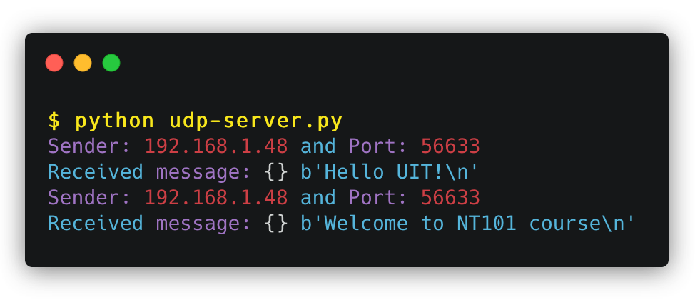


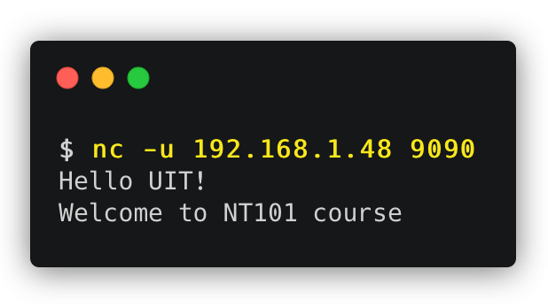
Receiving Packets Using Socket
Python version
Is it necessary to bind a specific port number in
Client program?
Server program?

Slide 9
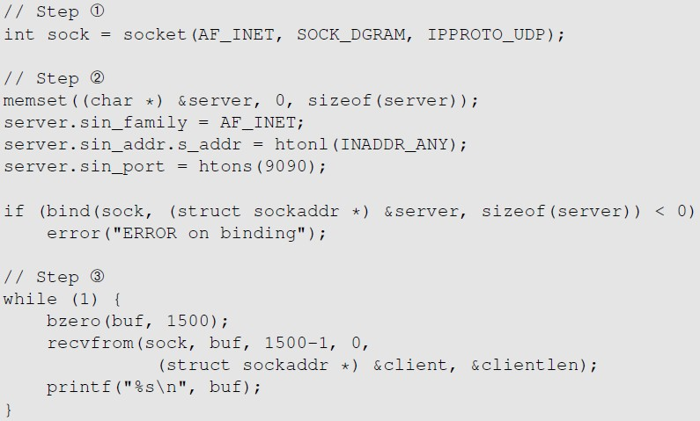
Receiving Packets Using Socket
C++ version
Create the socket
Provide information
about server
Receive packets

Slide 10

Packet Sniffing
High- and low-level approaches
NT101 – Network Security

Slide 11
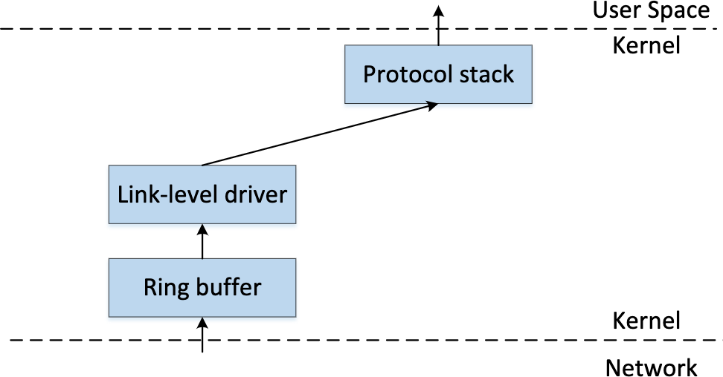
How to get a copy of packet?
Raw socket
Packet sniffing describes the process of capturing live data as they flow across a network
Raw Socket

Slide 12
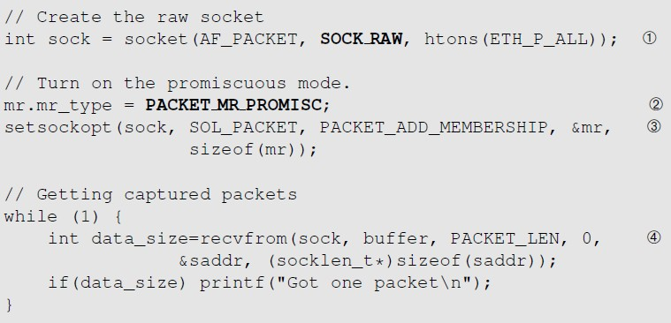
Receiving Packets Using Raw Socket
Get a copy of packet
Creating a raw socket
Capture all types of packets
Enable the promiscuous mode
Wait for packets

Slide 13
Promiscuous Mode
How to get everything in?
The frames that are not destined to a given NIC are discarded
When operating in promiscuous mode, NIC passes every frame received from the network to the kernel
If a sniffer program is registered with the kernel, it will be able to see all the packets
In Wi-Fi, it is called Monitor Mode

Slide 14
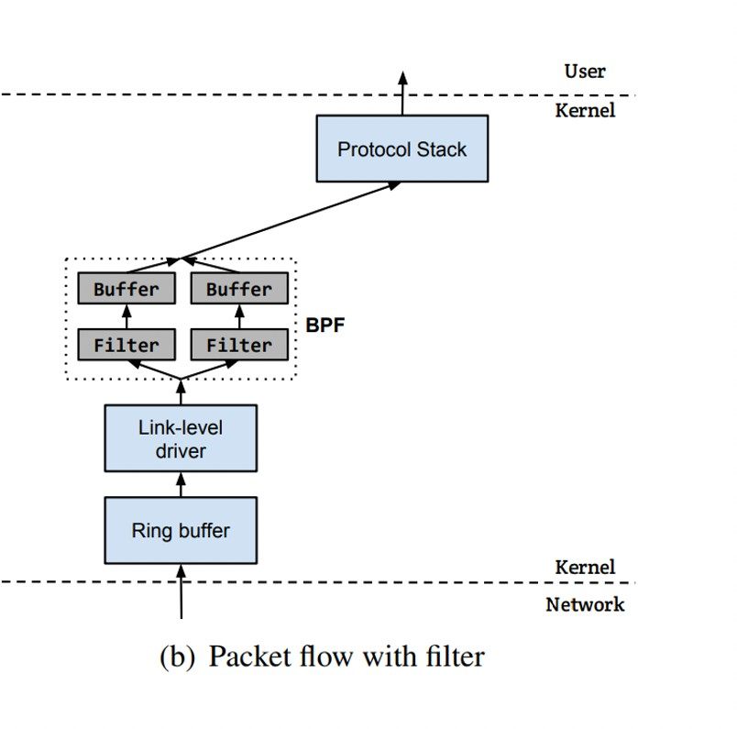
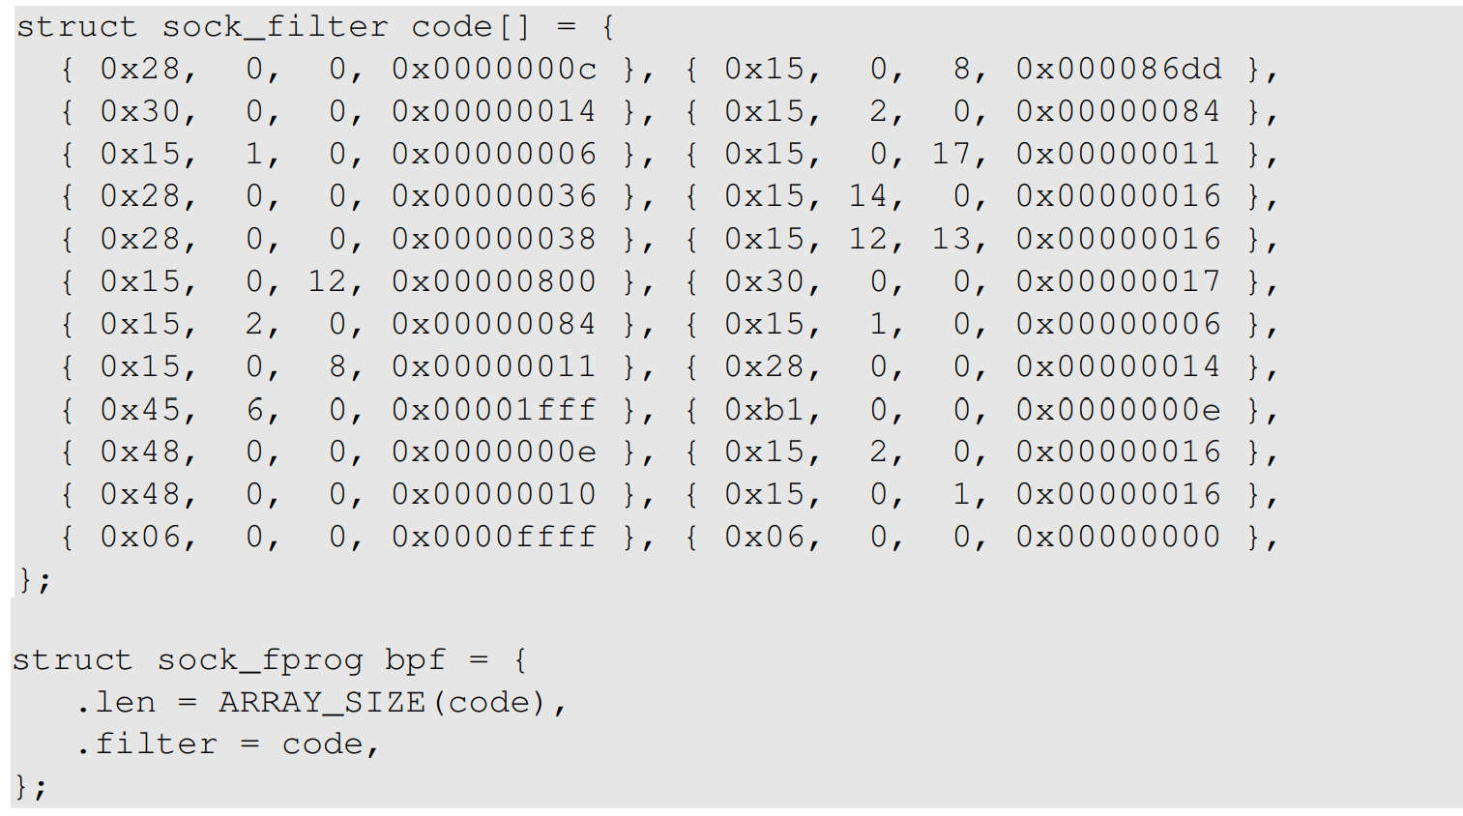
BSD Packet Filter (BPF)
Filtering out unwanted packets
BPF allows a user-program to attach a filter to the socket, which tells the kernel to discard unwanted packets.
An example of the compiled BPF code is shown here.

Slide 15
BSD Packet Filter (BPF)
Filtering out unwanted packets
A compiled BPF pseudo-code can be attached to a socket through
setsockopt()
setsockopt(sock, SOL_SOCKET, SO_ATTACH_FILTER, &bpf, sizeof(bpf))
When a packet is received by kernel, BPF will be invoked
An accepted packet is pushed up the protocol stack. See the diagram on the following slide.

Slide 16
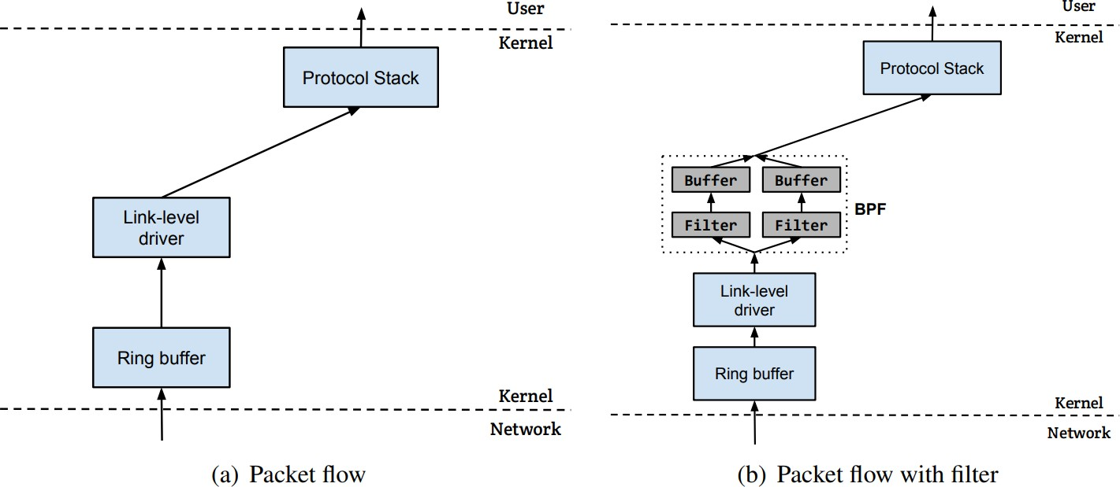
Packet Flow With/Without Filters
Below the IP Layer

Slide 17
Limitation of the Approach
Raw socket approach
This program is not portable across different operating systems.
Setting filters is not easy.
The program does not explore any optimization to improve performance.
The PCAP library was thus created.
It still uses raw sockets internally, but its API is standard across all platforms. OS specifics are hidden by PCAP’s implementation.
Allows programmers to specify filtering rules using human readable Boolean expressions.

Slide 18
PCAP: Packet Capture API
Overview
Originally coming from tcpdump
Supported by multiple platforms
Linux: libpcap
Windows: Winpcap and Npcap
Written in C. Other language implement wrappers
Basis for many tools
Wireshark, tcpdump, Scapy, Nmap, Snort

Slide 19
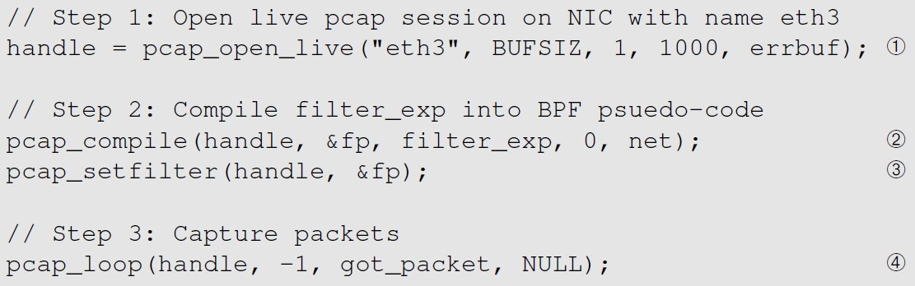
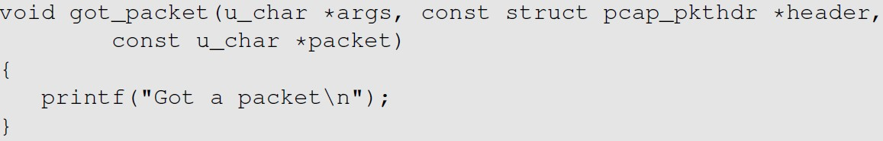

Packet Sniffing Using the PCAP API
C++ example
Initialize a raw socket, set the network device into promiscuous mode.
Filter
Invoke this function for every captured packet
https://github.com/kevin-w-du/BookCode/tree/master/Sniffing_Spoofing/C_sniff

Slide 20
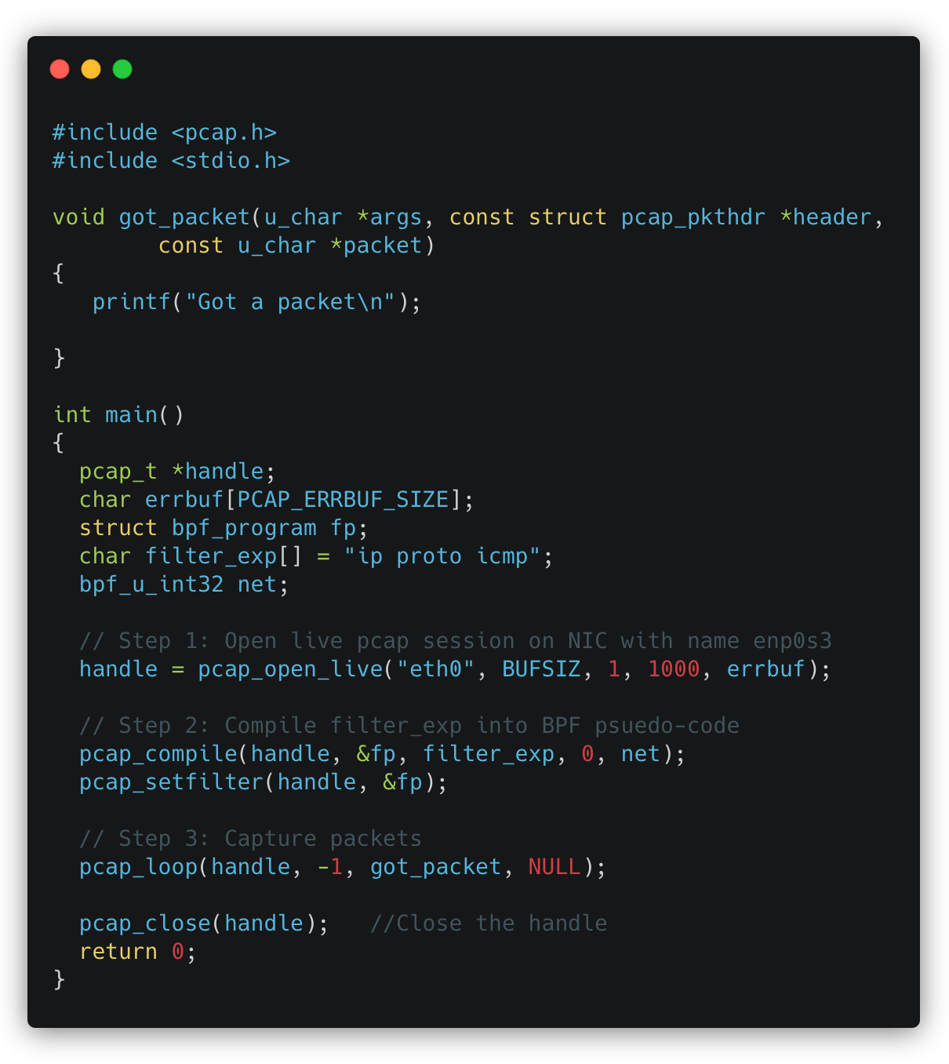
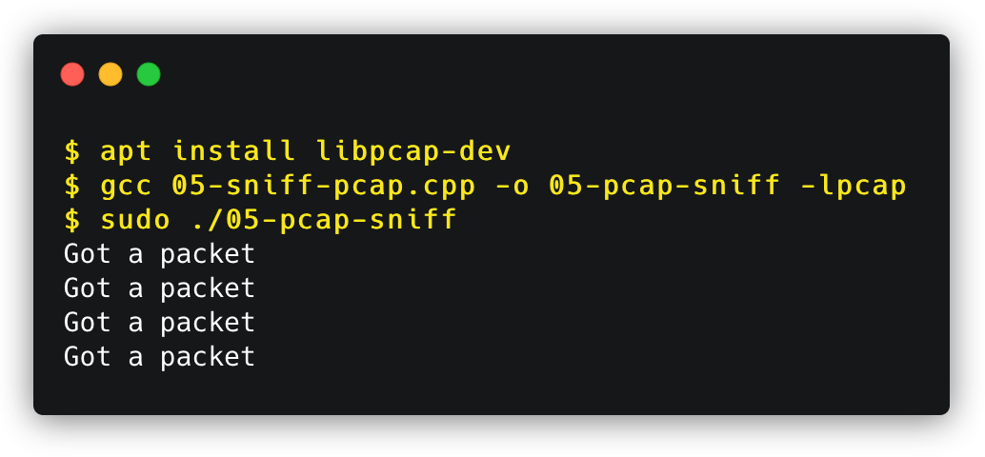


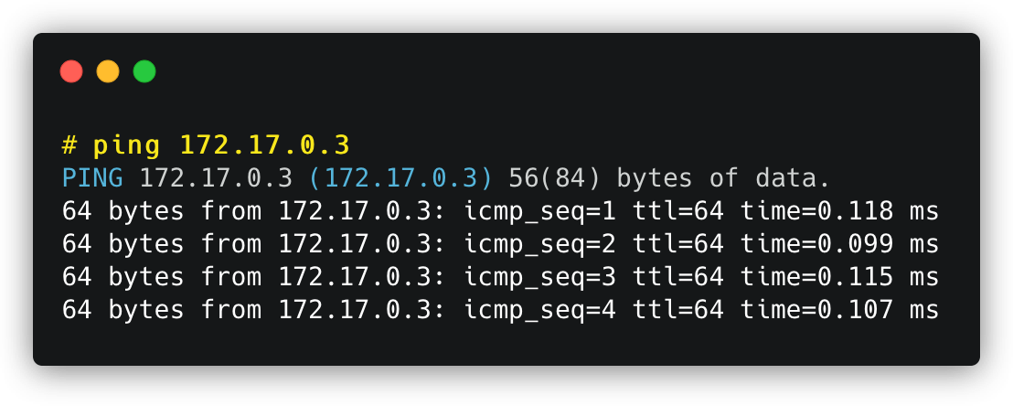
Packet Sniffing Using the PCAP API
C++ demonstration

Slide 21
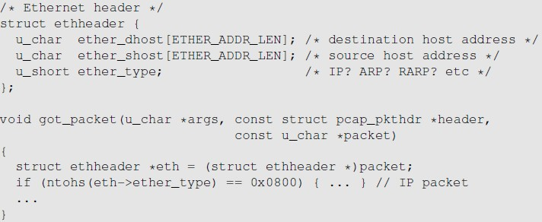
Processing Captured Packet
Ethernet Header
The packet argument contains a copy of the packet, including the Ethernet header. We typecast it to the Ethernet header structure.
Now we can access the field of the structure

Slide 22
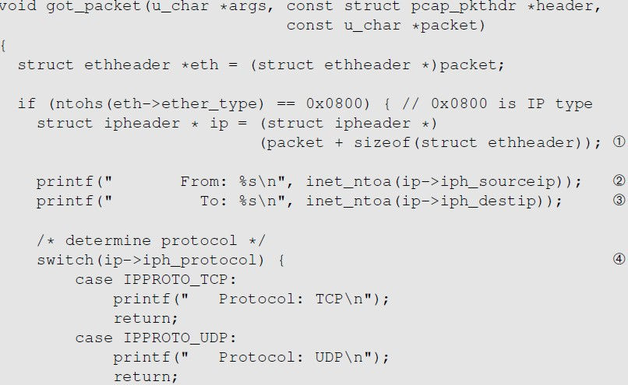
Processing Captured Packet
IP Header
Find where the IP header starts and typecast it to the IP Header structure.
Now we can easily access the fields in the IP header.

Slide 23
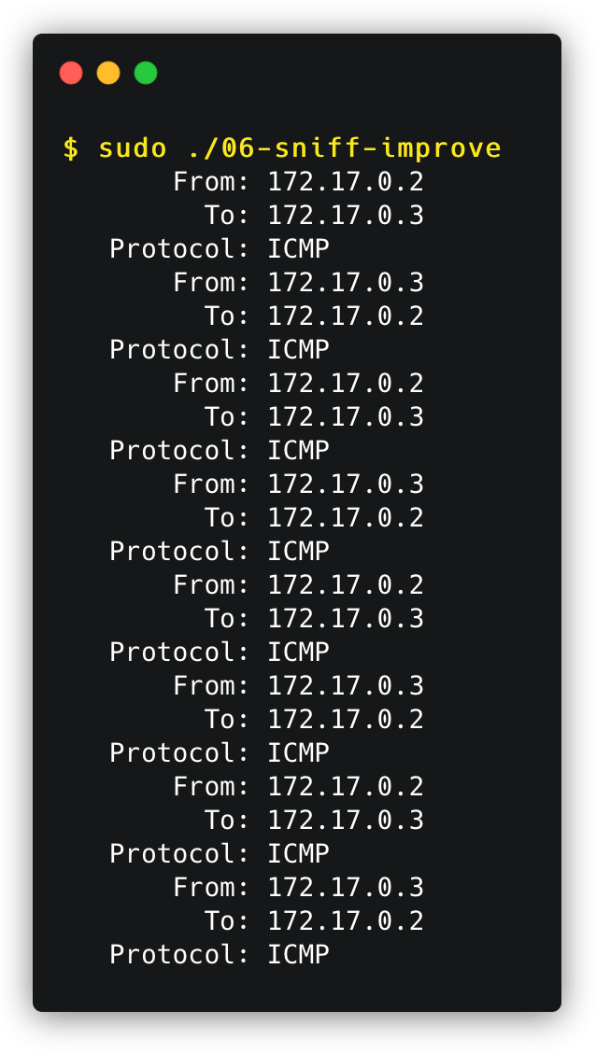
Processing Captured Packet
Improved sniffer
Host B: 172.17.0.2
Task: Re-implement these examples by yourself
Host A: 172.17.0.3

Slide 24
Further Processing Captured Packet
PCAP API
If we want to further process the packet, such as printing out the header of the TCP, UDP and ICMP, we can use the similar technique.
We move the pointer to the beginning of the next header and type-cast
We need to use the header length field in the IP header to calculate the actual size of the IP header
In the following example, if we know the next header is ICMP, we can get a pointer to the ICMP part by doing the following:

Slide 25

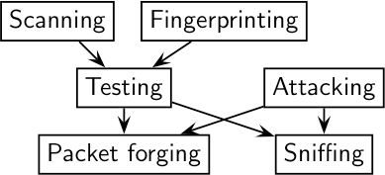
Sniffing using Scapy
Python + Scapy
What is Scapy?
Powerful modules (or programs) for packet manipulation
Packet parsing
Packet sending and receiving
Packet sniffing and spoofing
Adding new protocols
Many more applications
Installation
sudo pip3 install scapy
Import Scapy module in Python program
from scapy.all import *
https://scapy.net/

Slide 26
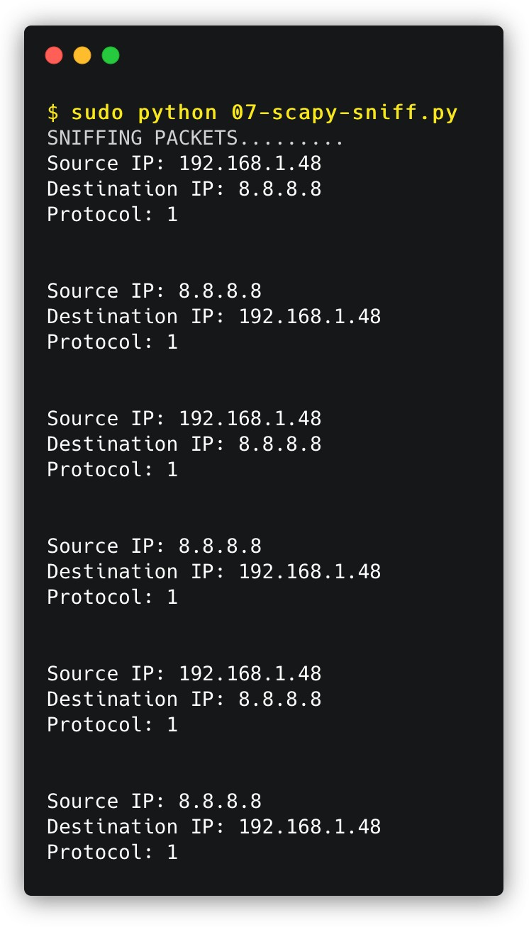
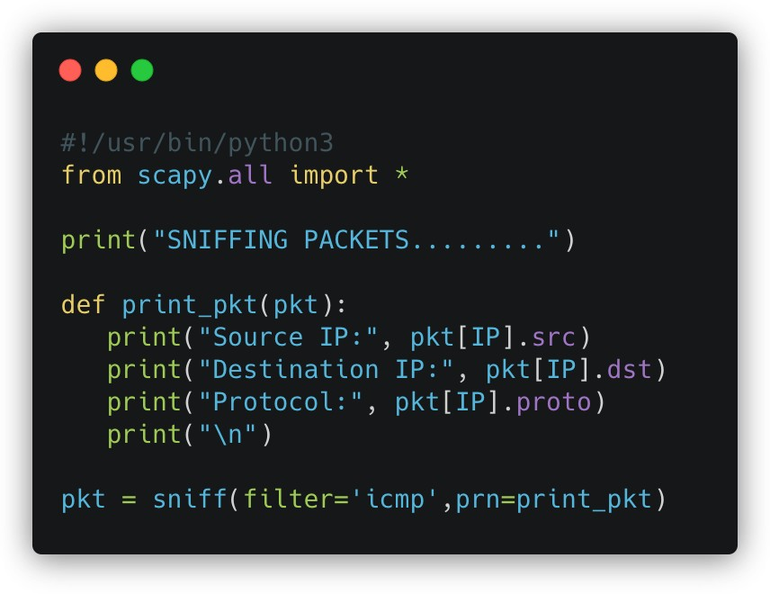


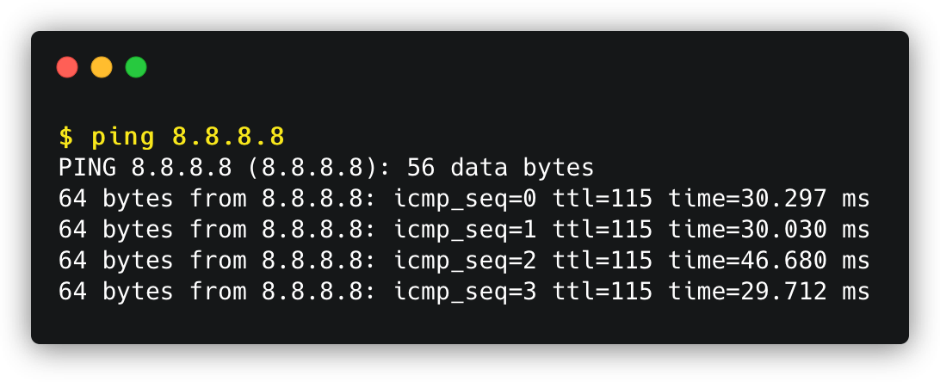
Packing Sniffing Using Scapy (cont.)
Example: ICMP

Slide 27
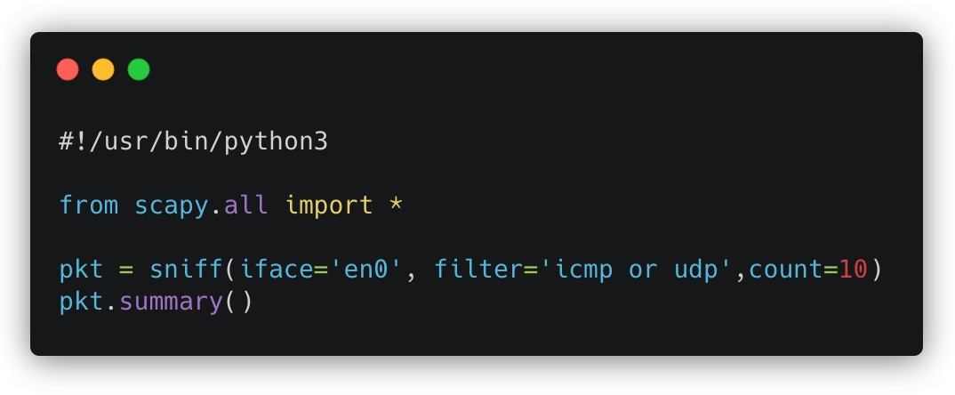
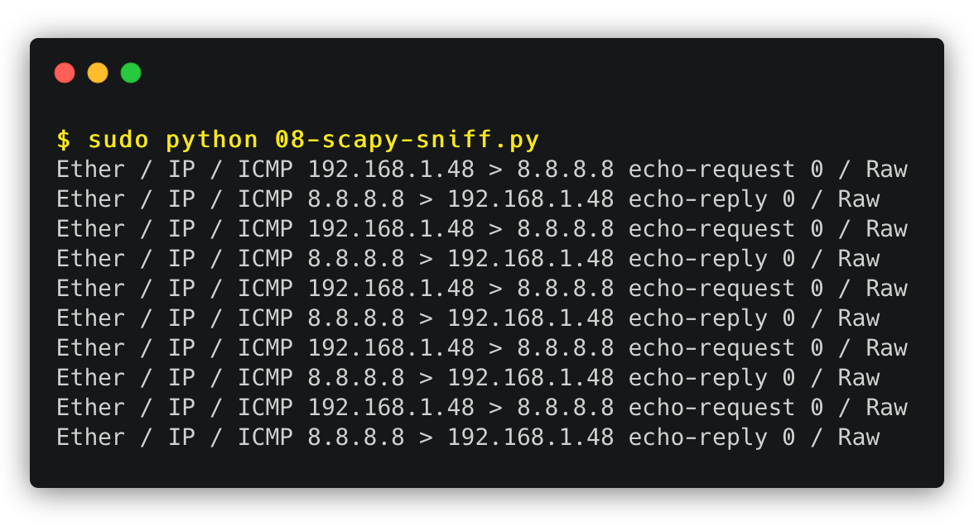


Packing Sniffing Using Scapy (cont.)
Example: Packet summary

Slide 28
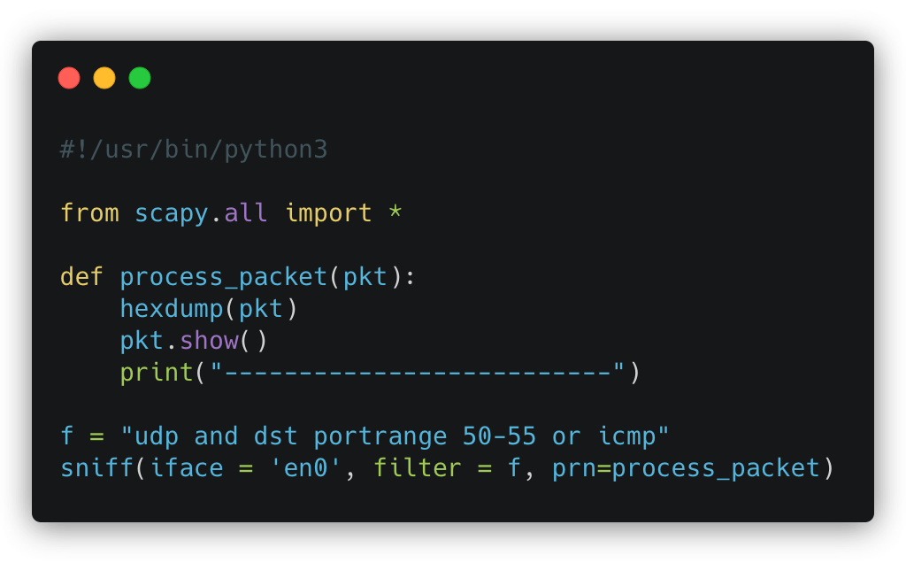
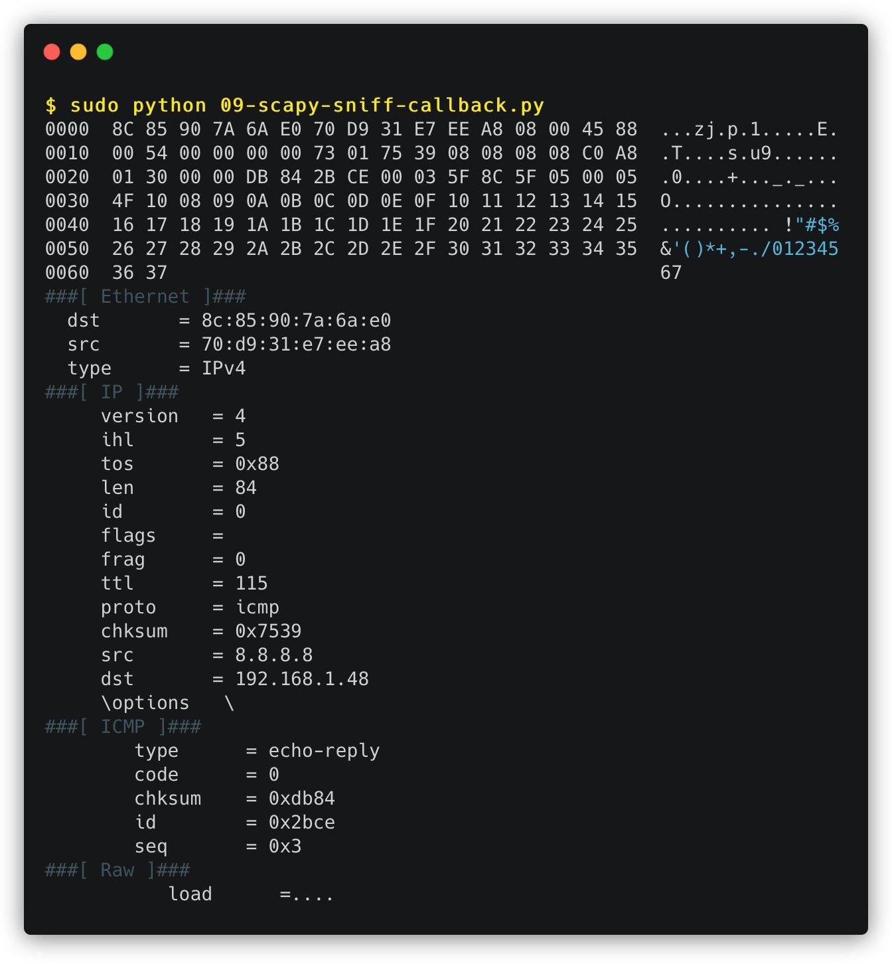
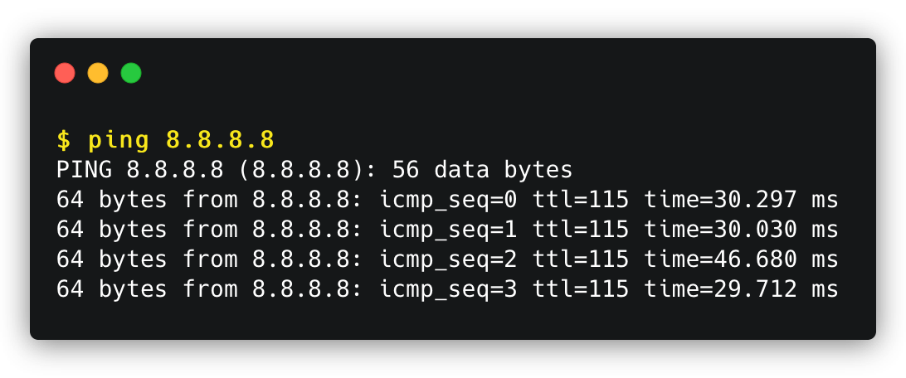
Packing Sniffing Using Scapy (cont.)
Example: Invoke a callback function

Slide 29
Get Information of Protocol classes
Scapy
Get Attribute names |  |  |  |  | Get Method names
>>> ls(IP) |  |  |  |  | >>> help(IP)
version : BitField (4 bits) ihl : BitField (4 bits) | = = | (4) (None) |  |  | Help on class IP in module scapy.layers.inet:
tos : XByteField | = | (0)
len : ShortField | = | (None) |  |  | class IP(scapy.packet.Packet, IPTools)
id : ShortField | = | (1) |  |  | | IP(*args, **kargs)
flags : FlagsField (3 bits) frag : BitField (13 bits) | = = | (<Flag (0) | 0 | ()>) | | | Add more powers to a class with an "src" attribute.
ttl : ByteField | = | (64) |  |  | |
proto : ByteEnumField | = | (0) |  |  | | Method resolution order:
chksum : XShortField | = | (None) |  |  | | IP
src : SourceIPField dst : DestIPField | = = | (None) (None) |  |  | | scapy.packet.Packet | scapy.base_classes.BasePacket
options : PacketListField | = | ([]) |  |  | | scapy.base_classes.Gen
 |  |  |  |  | | scapy.base_classes._CanvasDumpExtended
 |  |  |  |  | | IPTools
 |  |  |  |  | | builtins.object

Slide 30

Packet Spoofing
High- and low-level approaches
NT101 – Network Security

Slide 31
Packet Spoofing
Overview
When some critical information in the packet is forged, we refer to it as packet spoofing.
Many network attacks rely on packet spoofing.
Let’s review how to send packets without spoofing.

Slide 32
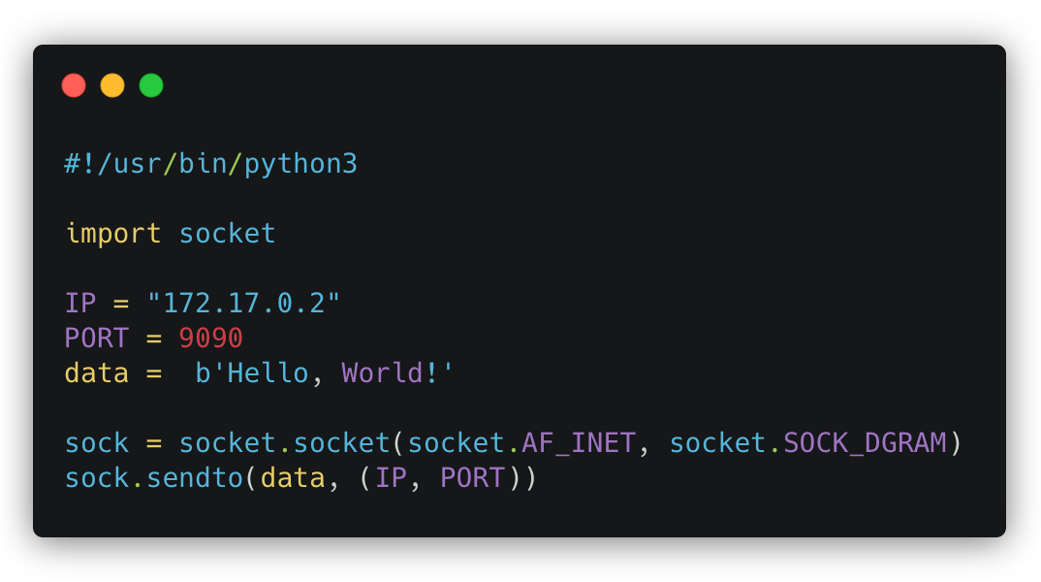
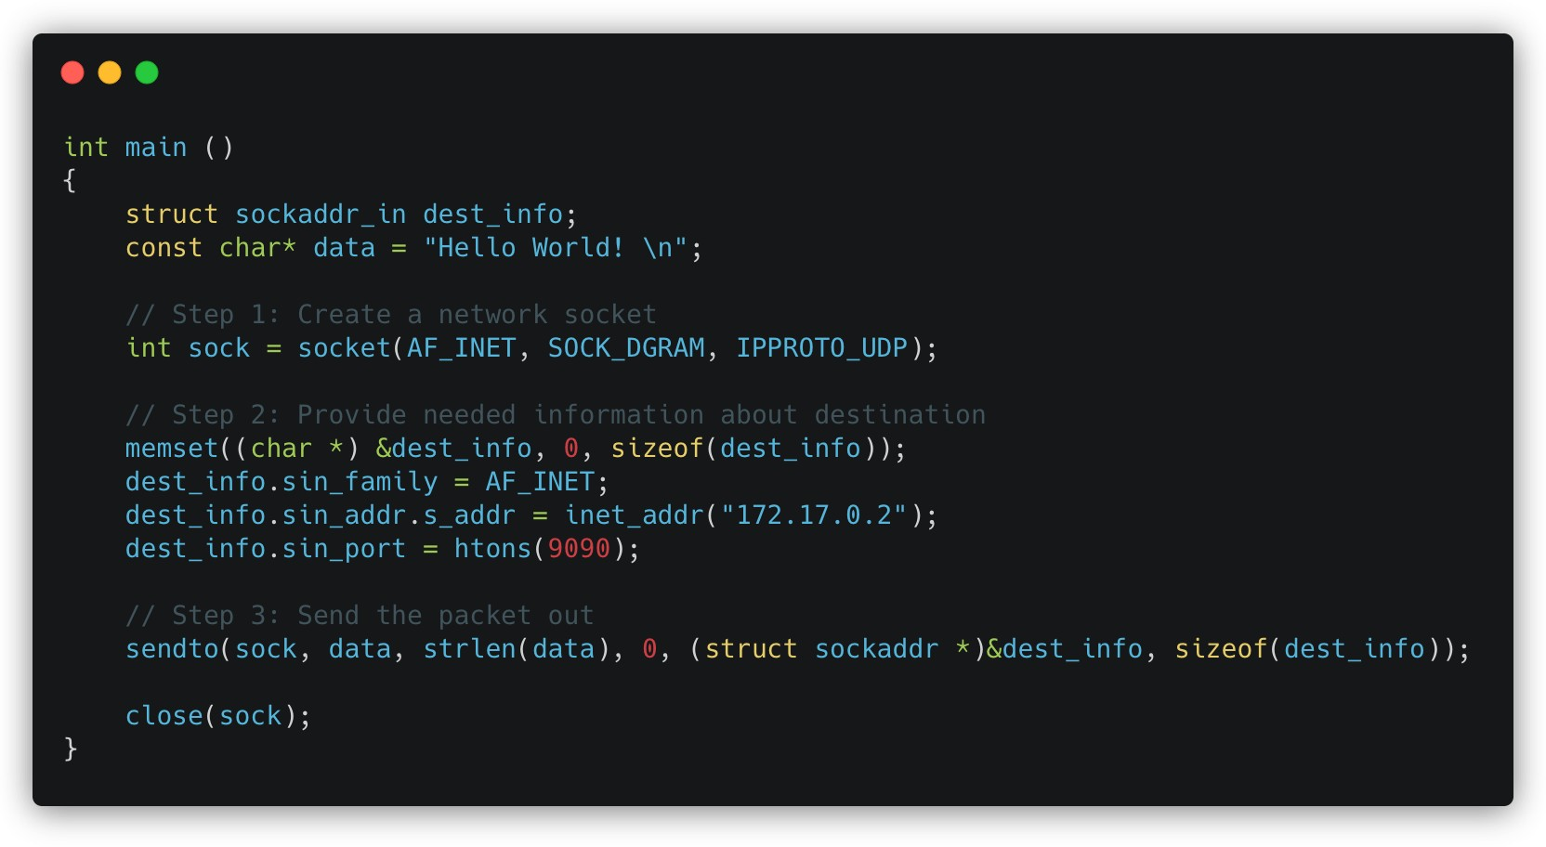
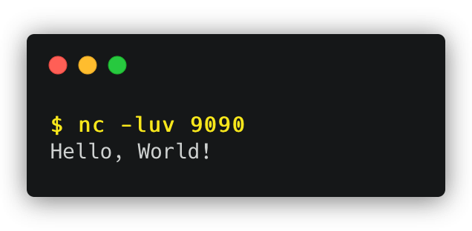
Sending Packets Without Spoofing
Recall
Python version
C++ version
Testing: Use the netcat (nc) command to run a UDP server on 172.17.0.2. We then run programs above from another machine. We can see that the message has been delivered to the server machine:

Slide 33
Spoofing Packets Using Raw Sockets
Spoofing approach
There are two major steps in packet spoofing:
Constructing the packet
Sending the packet out
Raw Socket

Slide 34
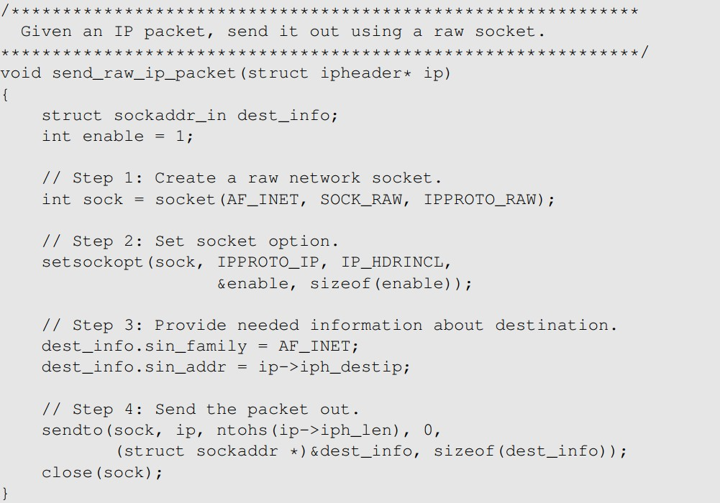
Spoofing Packets Using Raw Sockets
C++ version
We use setsockopt() to enable IP_HDRINCL on the socket. (include IP header)
For raw socket programming, since the destination information is already included in the provided IP header, we do not need to fill all the fields
Since the socket type is raw socket, the system will send out the IP packet as is.

Slide 35
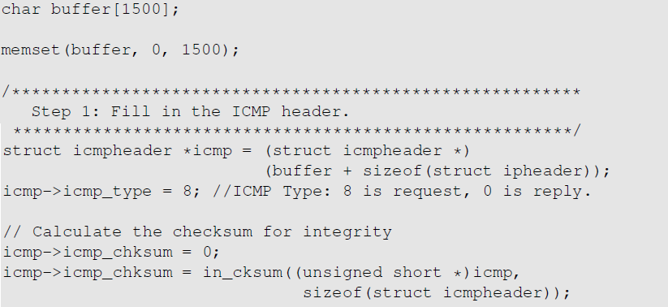
Spoofing Packets: Constructing the Packet
Fill in the ICMP Header
Find the starting point of the ICMP header, and typecast it to the ICMP structure
Fill in the ICMP header fields
https://github.com/kevin-w-du/BookCode/tree/master/Sniffing_Spoofing/C_spoof

Slide 36
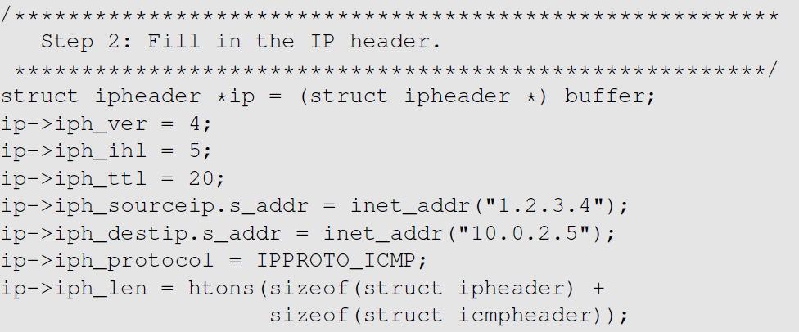
Spoofing Packets: Constructing the Packet
Fill in the IP Header
Typecast the buffer to the IP structure
Fill in the IP header fields
Finally, send out the packet

Slide 37

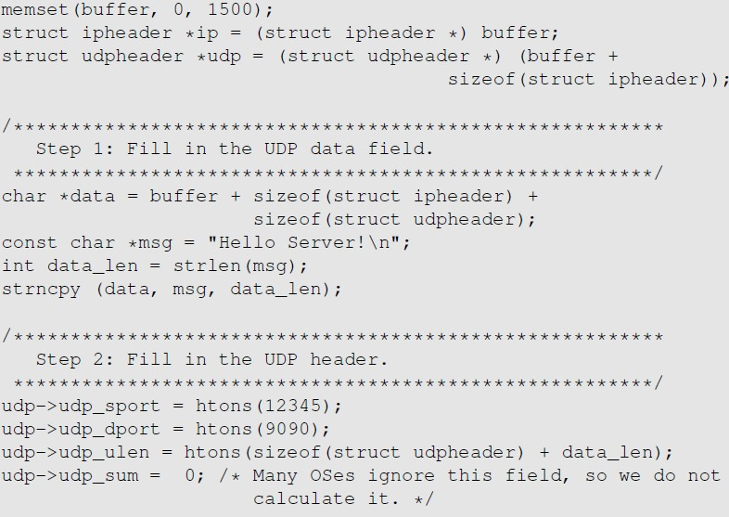
Spoofing UDP Packets (cont.)
Another example
Constructing UDP packets is similar, except that we need to include the payload data now.

Slide 38
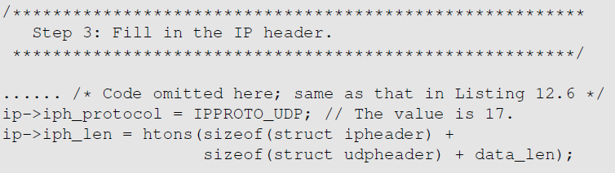
Spoofing UDP Packets
Another example
Testing: Use the nc command to run a UDP server on 10.0.2.5. We then spoof a UDP packet from another machine. We can see that the spoofed UDP packet was received by the server machine.

Slide 39
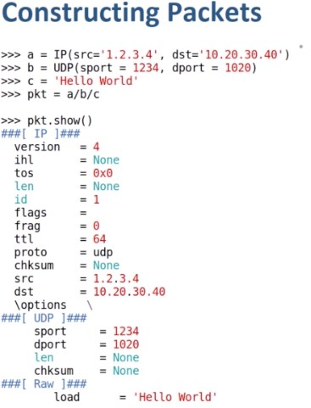
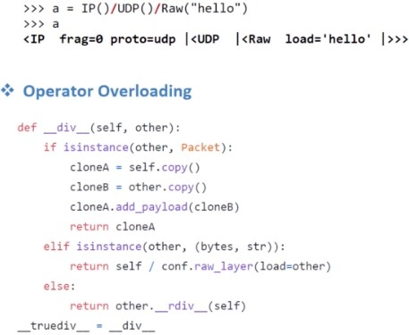
Spoofing ICMP & UDP Using Scapy
Constructing packets
Layer stacking

Slide 40
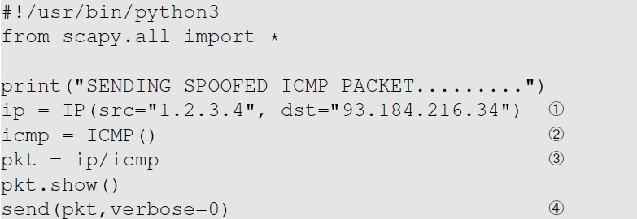
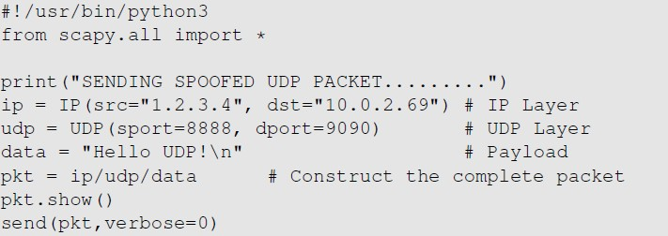
Spoofing ICMP & UDP Using Scapy
ICMP and UDP spoofing
ICMP Spoofing
UDP Spoofing

Slide 41
Sniffing and Then Spoofing
Sniff request and spoof reply
In many situations, we need to capture packets first, and then spoof a response based on the captured packets.
Procedure (using UDP as example)
Use PCAP API to capture the packets of interests
Make a copy from the captured packet
Replace the UDP data field with a new message and swap the source and destination fields
Send out the spoofed reply

Slide 42
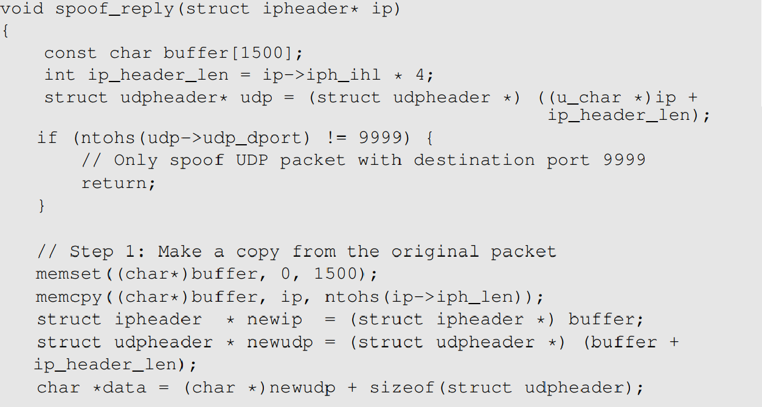
Sniffing and spoofing UDP Packet (cont.)
C++ version

Slide 43
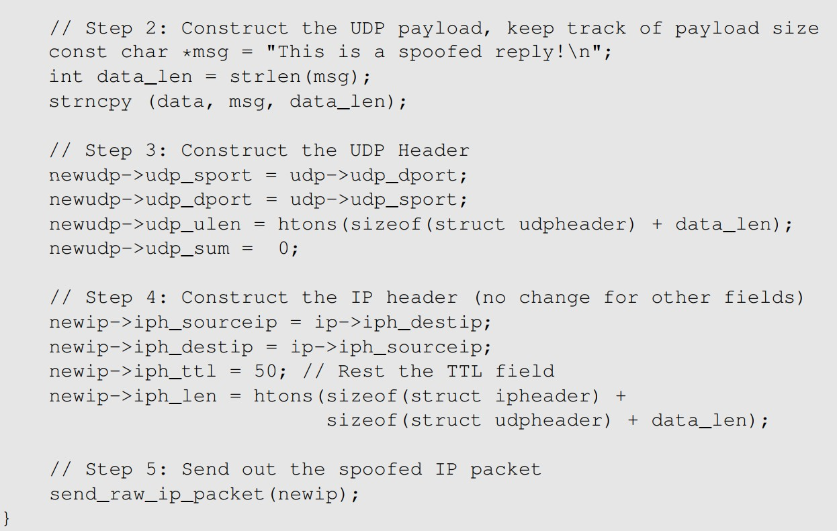
Sniffing and spoofing UDP Packet
C++ version

Slide 44
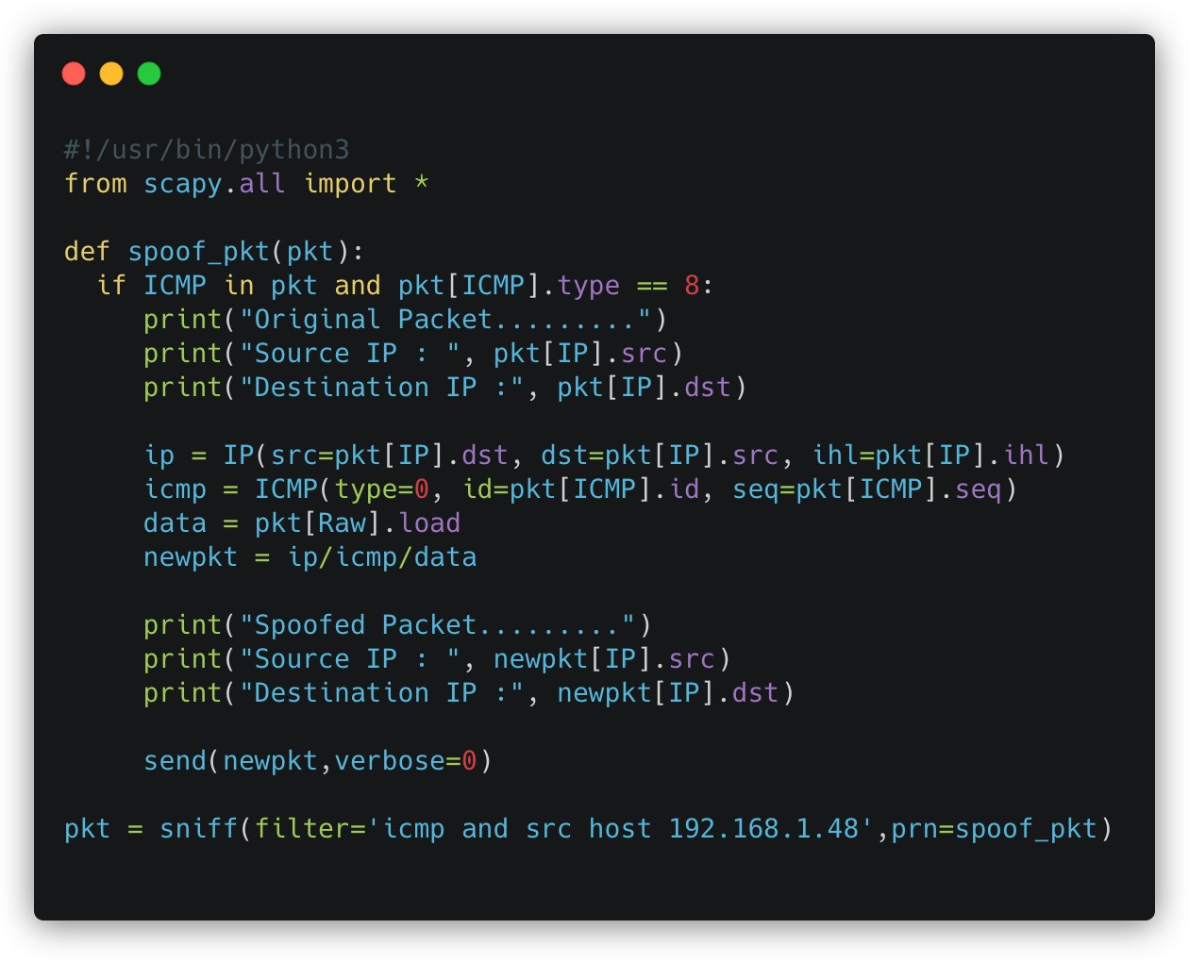
Sniffing and Then Spoofing Using Scapy (cont.)
ICMP Spoofing

Slide 45
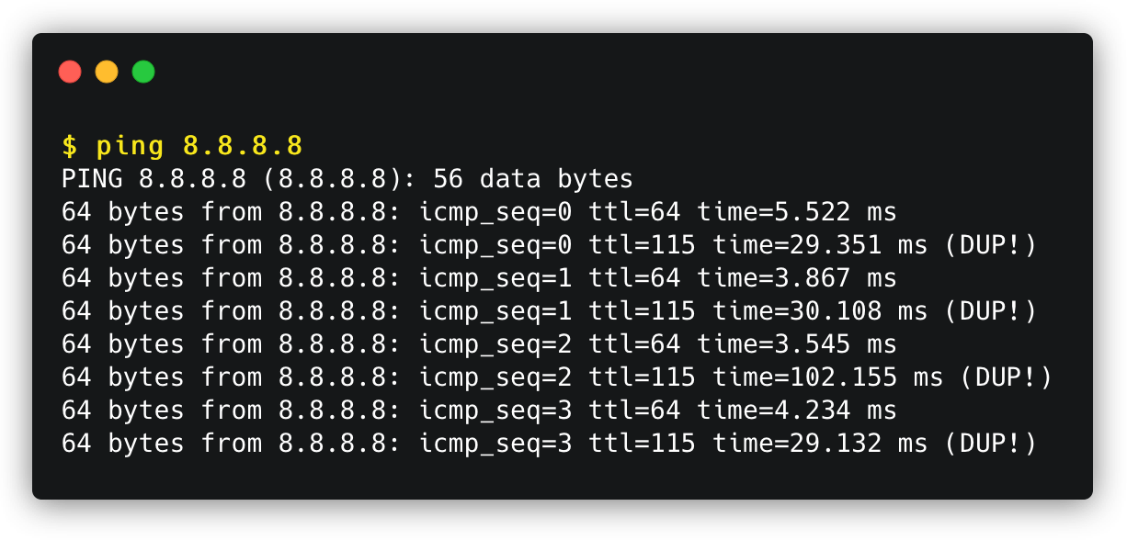
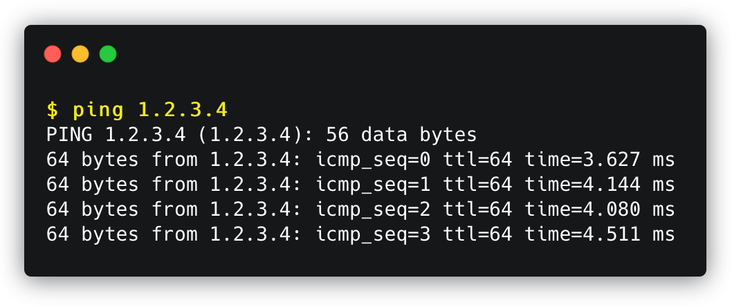
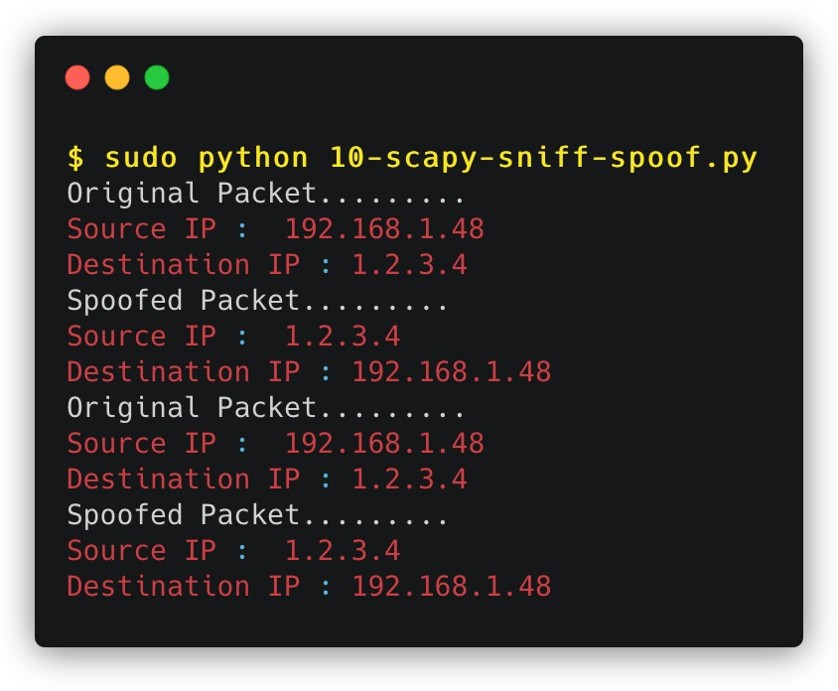

Sniffing and Then Spoofing Using Scapy
ICMP Spoofing

Slide 46
Packet Spoofing: Scapy v.s C
A comparison
Python + Scapy
Pros: constructing packets is very simple
Cons: much slower than C code
C Program (using raw socket)
Pros: much faster
Cons: constructing packets is complicated
Hybrid Approach
Using Scapy to construct packets
Using C to slightly modify packets and then send packets
Example: Kaminsky DNS attack (will be discussed)

Slide 47

Endianness
Byte order
NT101 – Network Security

Slide 48

Endianness
Byte order
Endianness: a term that refers to the order in which a given multi-byte data item is stored in memory.
Little Endian: store the most significant byte of data at the highest address
Big Endian: store the most significant byte of data at the lowest address

Slide 49

Endianness In Network Communication
Host order and network order
Computers with different byte orders will “misunderstand” each other.
Solution: agree upon a common order for communication
This is called “network order”, which is the same as big endian order
All computers need to convert data between “host order” and “network order” .

Slide 50
Summary
What have we learned?
Socket programming
Packet sniffing
Using raw socket
Using PCAP APIs
Packet spoofing
Using C++
Using Scapy
Sniffing and the spoofing
Byte order: Endianness

Slide 51

Homework
Lab exercise
Packet Sniffing and Spoofing Lab (Link)
The objective of this lab is two-fold:
learning to use the tools and understanding the technologies underlying these tools.
students will write simple sniffer and spoofing programs, and gain an in-depth understanding of the technical aspects of these programs.
Working in a team (your final-project team) or individually.

Slide 52

For next time…
Looking ahead
Ready for next class:
Tentative topic: Link (MAC) Layer and atttacks
Reading and practicing (in advance):
SEED book, Chapter 16
Refs: https://www.handsonsecurity.net/resources.html
SEED Lab: ARP Cache Poisoning Attack Lab
Refs: https://seedsecuritylabs.org/Labs_16.04/Networking/ARP_Attack/
o Final-project Proposal report
to be announced at courses.uit.edu.vn

Slide 53

Today end,
Congrats!

